Slide 1
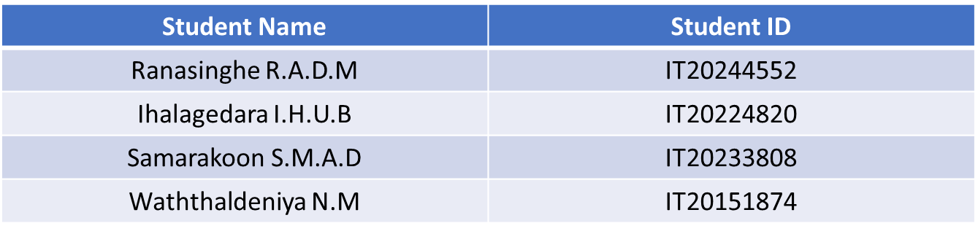

SMART SYSTEM FOR OPTIMIZED ORGANIC CROP ROTATION USING PRECISION AGRICULTURE DATA
PROGRESS PRESENTATION 2
2023-113
Student Name
Student I
Project ID: TMP-23-113
09/05/2023
1

Slide 2
Objectives
Specific Objective: The main objective of this system is to provide the opportunity for the stakeholders to create their crop rotation plan with the help analysis of soil, climate and pests and also provide other agriculture supports.
Sub Objective :
Gather soil data using IoT device and use it as parameters in an algorithm
Identify the pests and diseases based on the provided image and provide solutions through an algorithm.
Gather climate data using IoT device and use it as a parameters in an algorithm
Project ID: TMP-23-113
09/05/2023
2

Slide 3
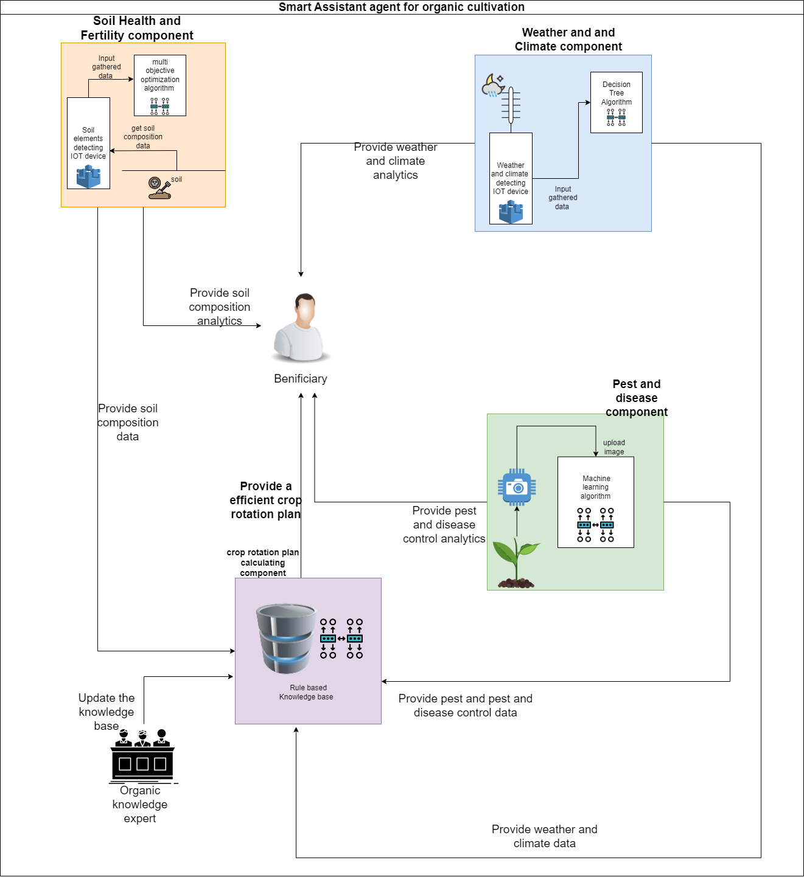
Proposed System Overview Diagram
Project ID: TMP-23-113
09/05/2023
3

Slide 4
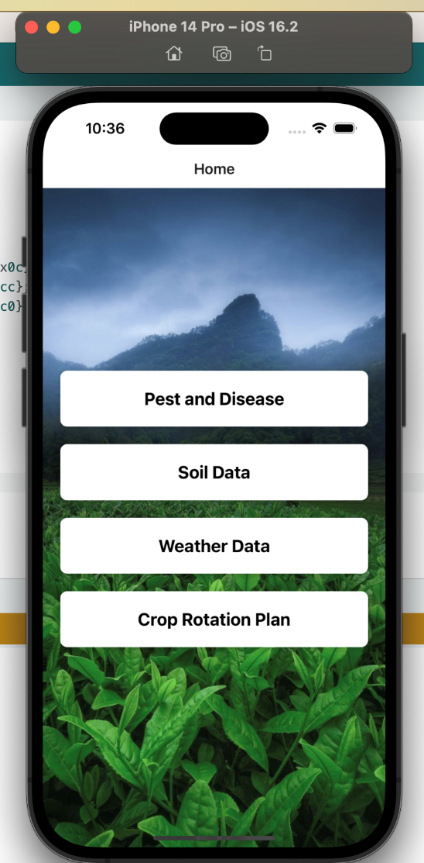
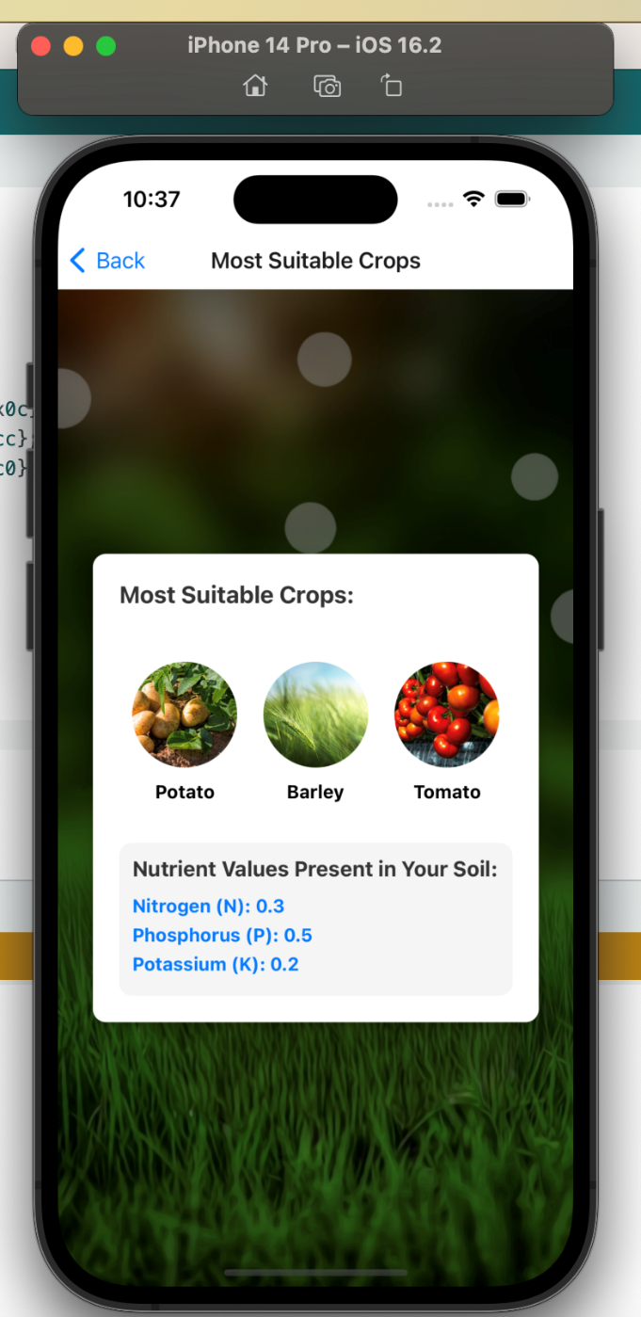
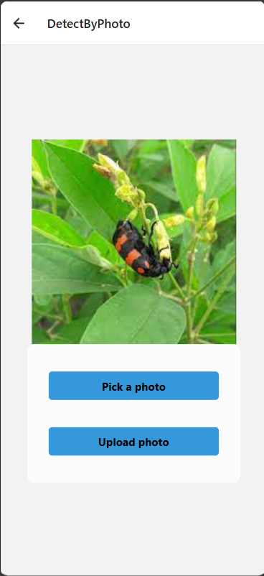
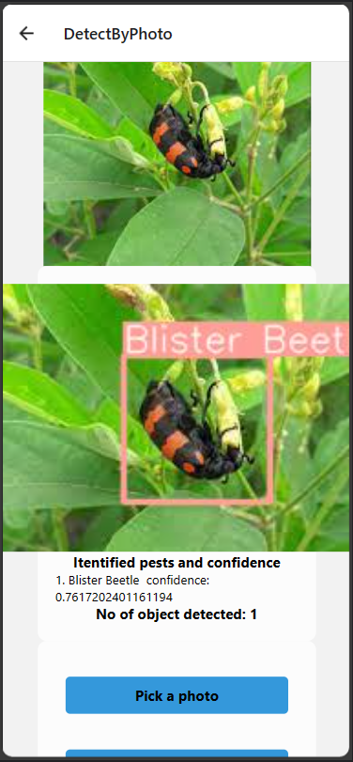
System Applications
Project ID: TMP-23-113
09/05/2023
4

Slide 5
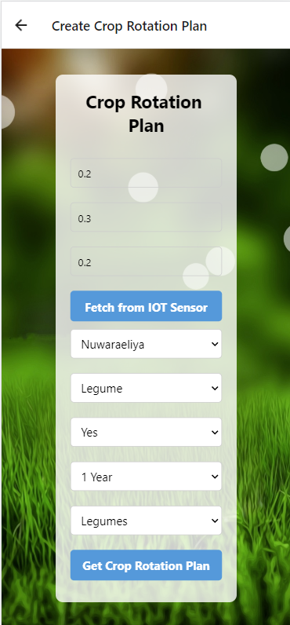
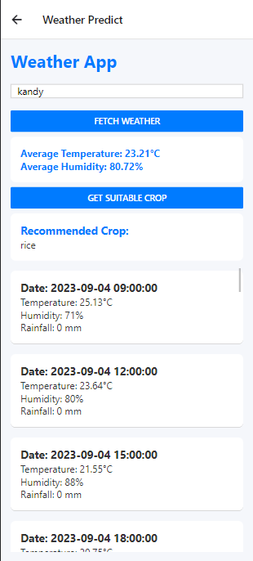
System Applications
Project ID: TMP-23-113
09/05/2023
5

Slide 6
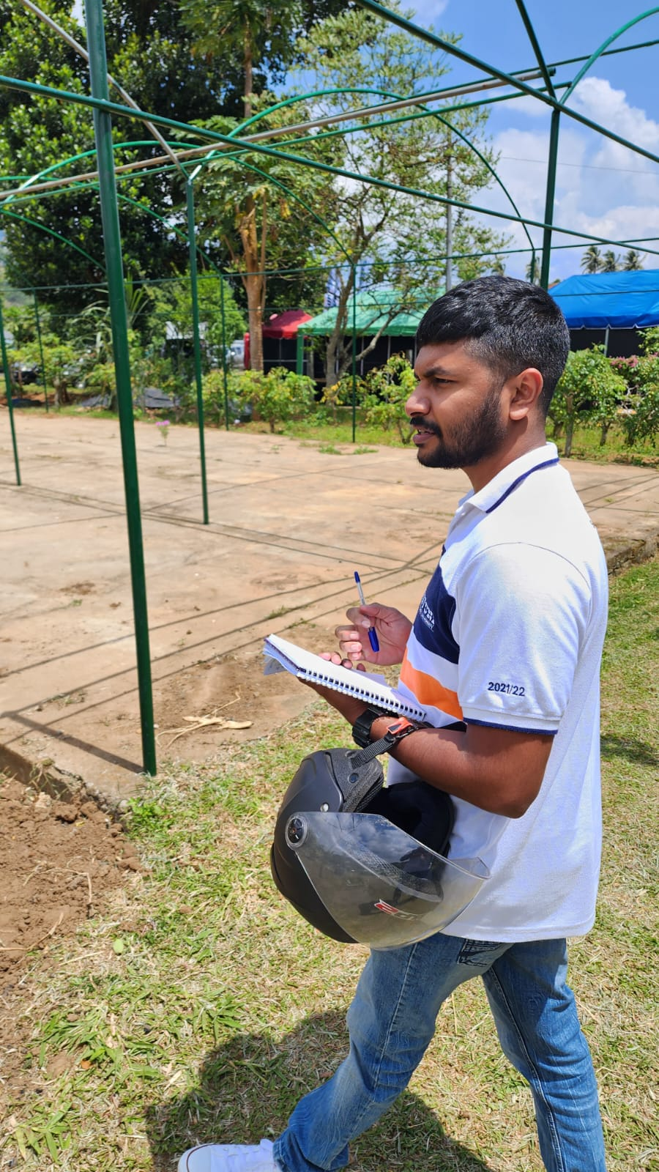
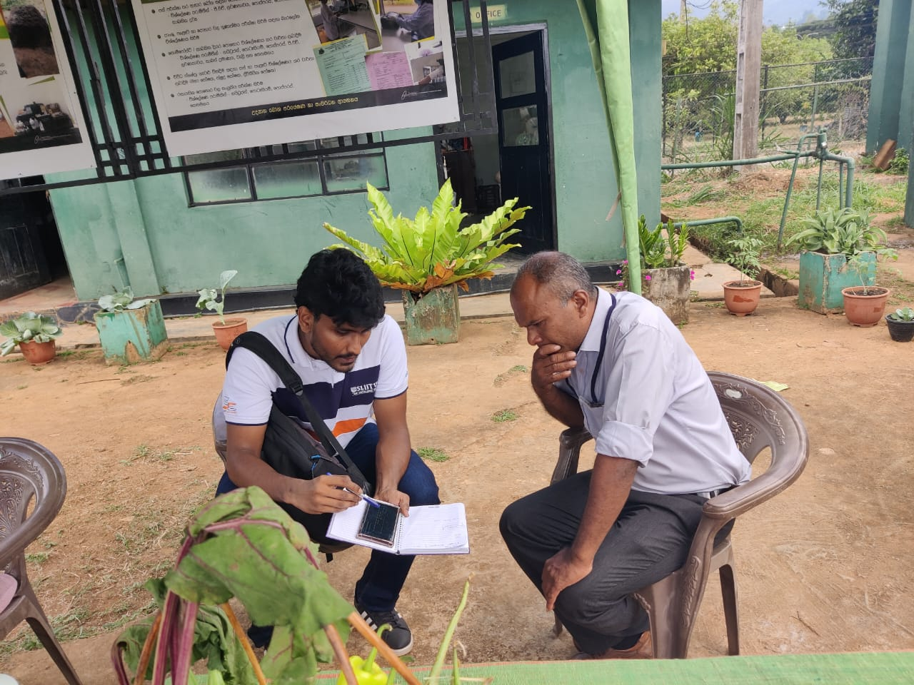
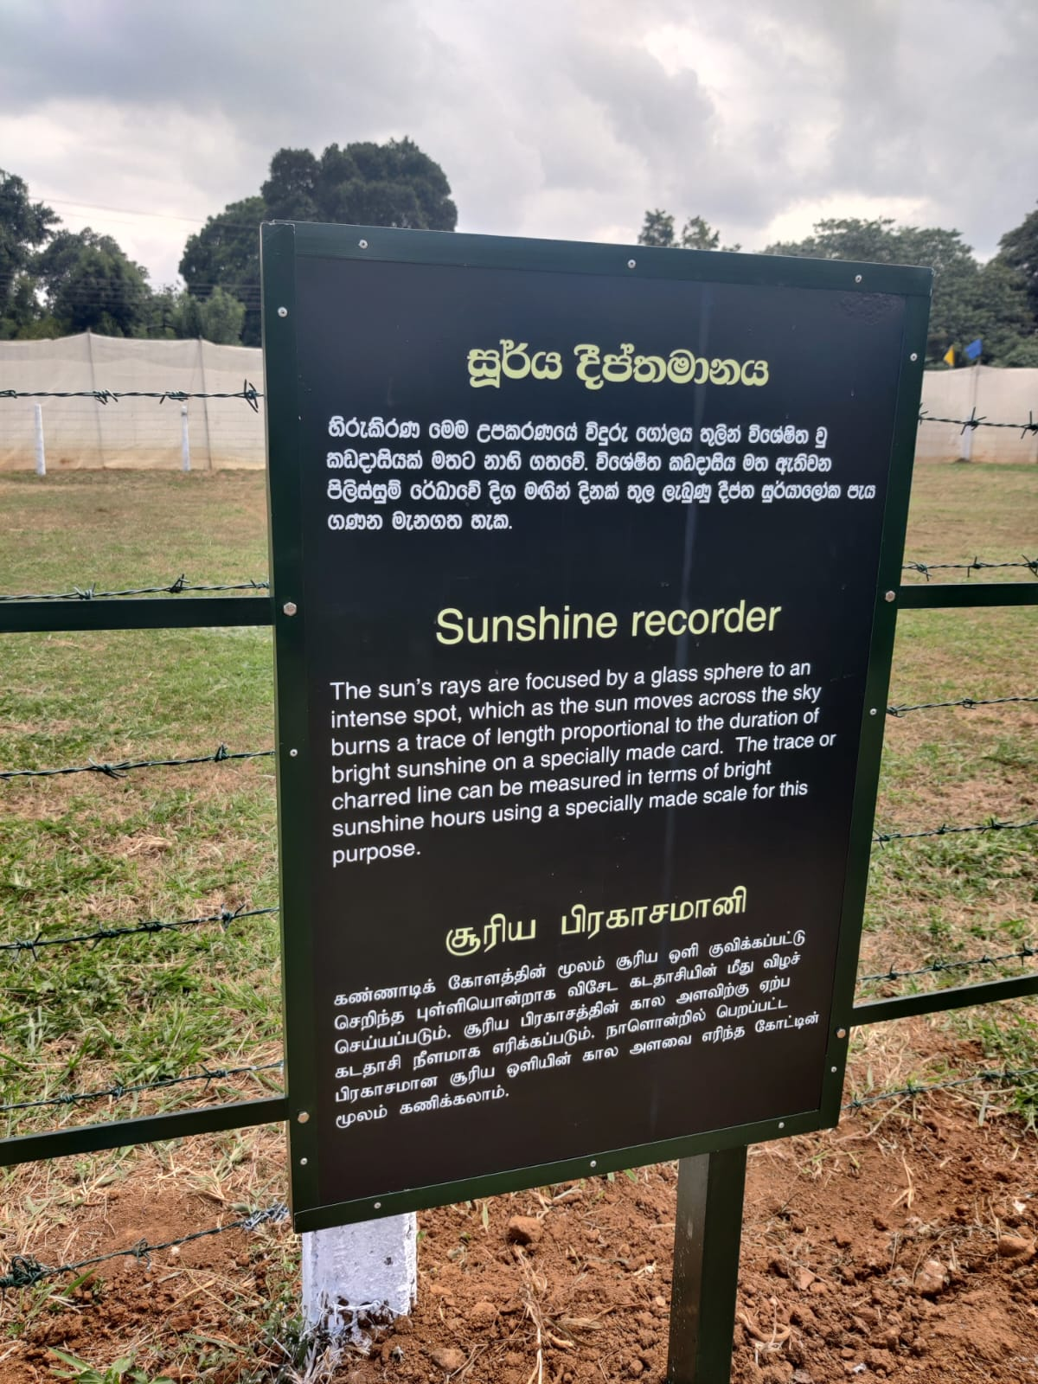
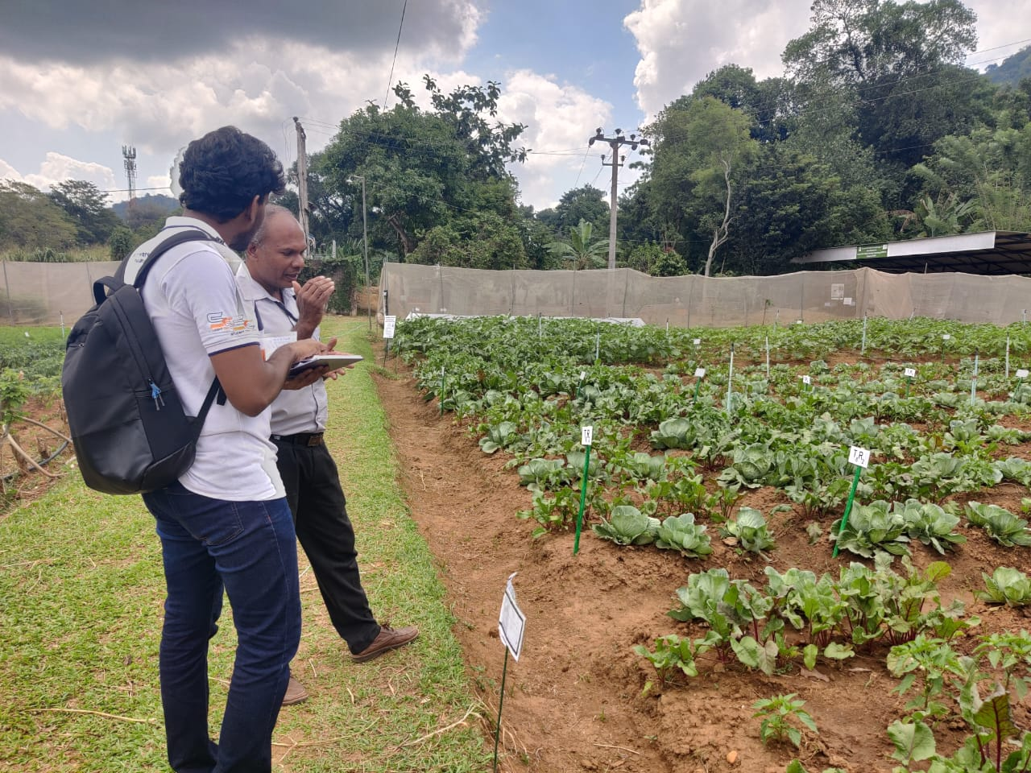
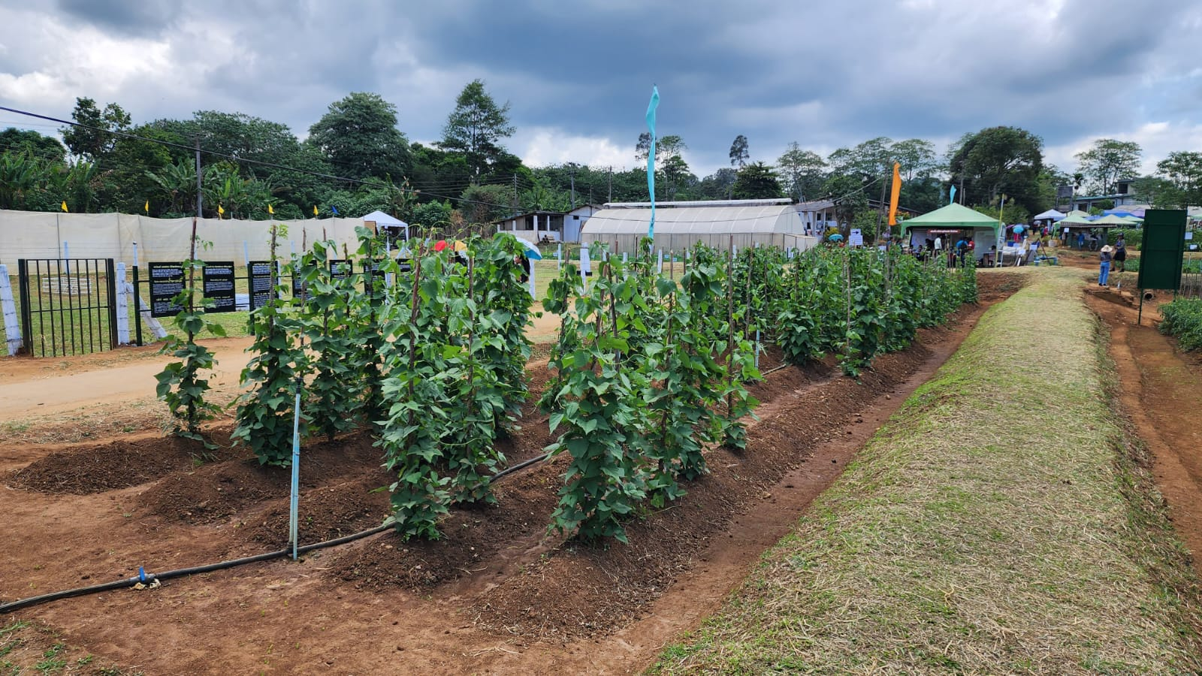
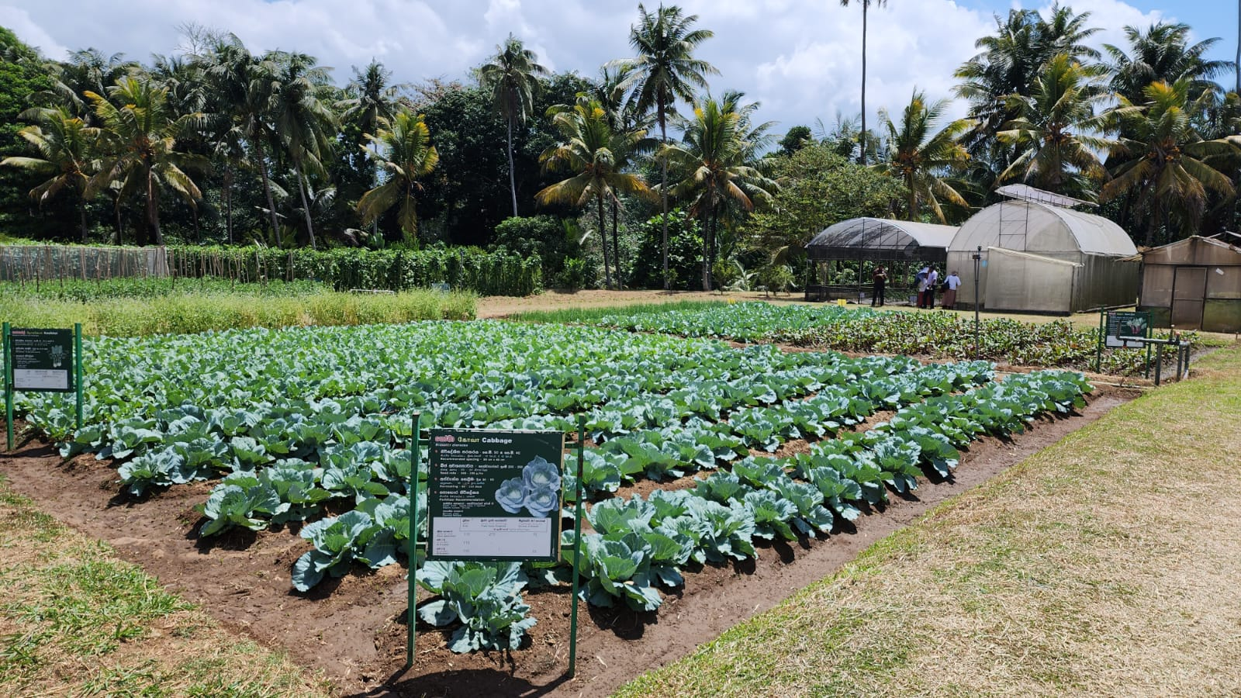
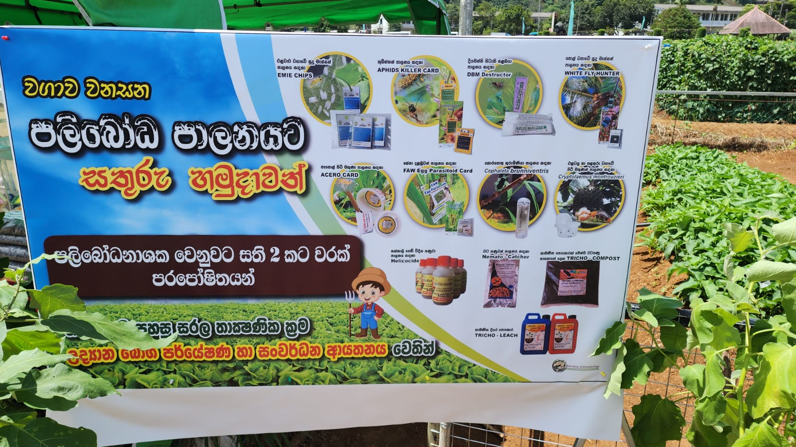
Visit to Gannoruwa
Project ID: TMP-23-113
09/05/2023
6

Slide 7
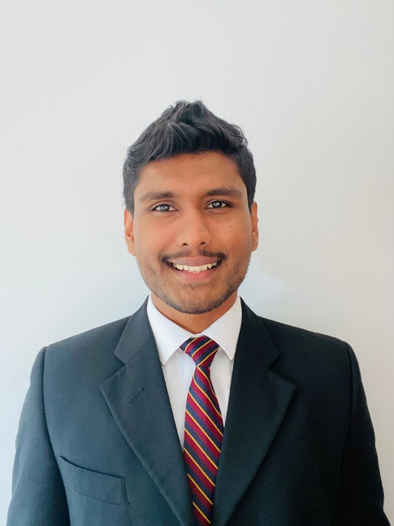
IT20244552 | Ranasinghe R.A.D.M.
Bachelor of Science (Hons) in Information Technology Specializing in Software Engineering
IT20244552 | Ranasinghe R.A.D.M. | Project ID: TMP-23-113
09/05/2023
7

Slide 8
Target Problem
Problem: No existing software solution utilizes precision agriculture data for crop rotation planning.
Crop rotation is crucial for soil health, pest management, and maximizing yields.
Current agricultural software lacks integrated crop rotation planning capabilities.
Farmers manually collect and analyze data, leading to suboptimal decisions and reduced yields.
IT20244552 | Ranasinghe R.A.D.M. | Project ID: TMP-23-113
09/05/2023

Slide 9
Target Solution
Solution: Develop a software tool that leverages precision agriculture data for optimized crop rotation plans.
Benefits: Improved decision-making, increased productivity, and enhanced sustainability.
Factors considered: Soil health, Weather data, Pest attack history, Previous grown crops, Farmer choice, No of years for crop rotation.
Powering efficient and sustainable farming practices through technology.
IT20244552 | Ranasinghe R.A.D.M. | Project ID: TMP-23-113
09/05/2023

Slide 10
CURRENT PROGRESS – IT20244552 (80%)
Created the crop rotation rules for Nuwaraeliya District to produce the crop rotation plan – Still in development stage
Implemented the web application that Agri experts are going to use to update rules(Drools workbench(Business central))
Implanted KIE server that runs the rule engine(WILDFLY)
Implemented the mobile app views to create crop rotation plan and view the crop rotation plan
IT20244552 | Ranasinghe R.A.D.M. | Project ID: TMP-23-113

Slide 11
NEXT EXPECTED PROGRESS (100% COMPLETION) IT20244552
Finish drools DMN rules for Nuwaraeliya district
Test and validate (Accuracy test)
Deploy the KIE server, Business Central Workbench on cloud
IT20244552 | Ranasinghe R.A.D.M. | Project ID: TMP-23-113
09/05/2023

Slide 12
Results
Rule Base output accuracy – 100%
Machine learning model output accuracy - ??
Building upon the successful results observed in the Nuwara Eliya district, further expansion and refinement of the system can be pursued with confidence.
IT20244552 | Ranasinghe R.A.D.M. | Project ID: TMP-23-113
09/05/2023

Slide 13
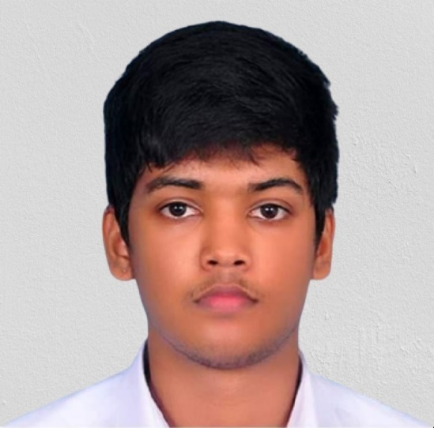
IT20233808 Samarakoon S.M.A.D
Bachelor of Science (Hons) in Information Technology Specializing in Software Engineering
05/23/2023
13
IT20233808 | Samarakoon S.M.A.D. | Project ID: TMP-23-113

Slide 14
Target Solution
Problem: No existing software that predict Crops In Realtime using IOT soil data and machine learning.
Knowing what crops will be suitable for a specific soil is very important .
By knowing the most suitable crops for a specific soil it allow farmers and any other beneficiary to get high yields with very low fertilizers. Because the soil is already in good levels of nutrients for that crop to grow
IT20244552 | Samarakoon S.M.A.D. | Project ID: TMP-23-113
09/05/2023

Slide 15
Target Solution
Solution: Develop an application that predicts most suitable crops for a particular soil by using IOT and machine learning.
Benefits: Improved decision-making, increased productivity, and enhanced sustainability.
Factors considered: Nitrogen level, Phosphorus level, potassium level
Powering efficient and sustainable farming practices through technology.
IT20244552 | Samarakoon S.M.A.D. | Project ID: TMP-23-113
09/05/2023

Slide 16
CURRENT PROGRESS (95% COMPLETION) IT20233808
Created the IOT devices to gather soil data required for decision making algorithm.
Completed the CSI algorithm to find out the most optimized crop for a particular soil.
Implemented a decision algorithm in a flask server.
Implemented the react native mobile app to display most suitable crop.
Configured the IOT device with the mobile application to get real time soil.
Trained a random forest model, decision tree model and a support vector classifier model to find the most optimized crop using the training data gathered from the decision algorithm and from an externally gathered data set from reliable sources
05/23/2023
IT20233808 | Samarakoon S.M.A.D. | Project ID: TMP-23-113

Slide 17
CURRENT PROGRESS (100% COMPLETION) IT20233808
Deploy and host the component
Use a hosted server address for the application
05/23/2023
IT20233808 | Samarakoon S.M.A.D. | Project ID: TMP-23-113

Slide 18
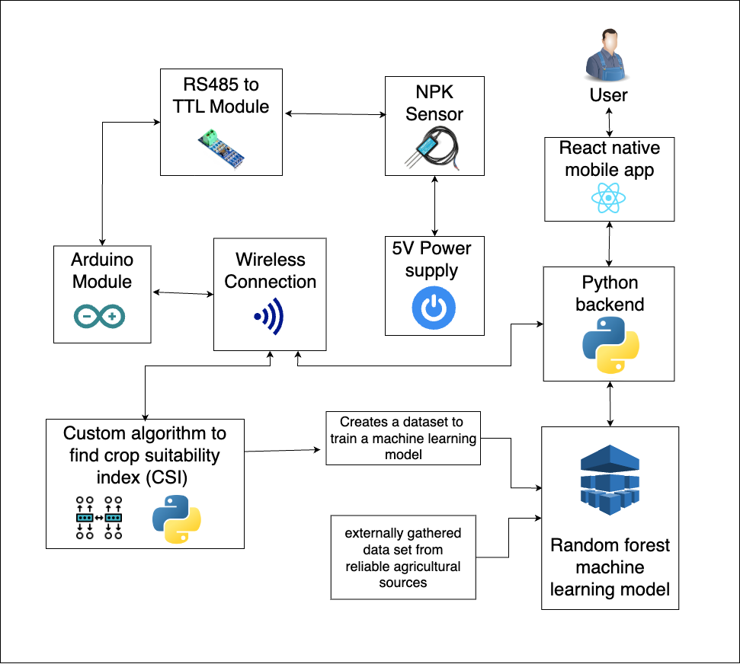
Methodology
IT20233808 | Samarakoon S.M.A.D. | Project ID: TMP-23-113
05/23/2023

Slide 19
Specific and Sub Objectives
Main Objective–
The main objective is to predicts the most suitable crops Realtime for a particular soil sample by using IOT sensors and machine learning models.
05/23/2023
IT20233808 | Samarakoon S.M.A.D. | Project ID: TMP-23-113

Slide 20
Specific and Sub Objectives
Sub Objective – Dataset Creation :-
Create a CSI algorithm to generate a dataset
05/23/2023
IT20233808 | Samarakoon S.M.A.D. | Project ID: TMP-23-113

Slide 21
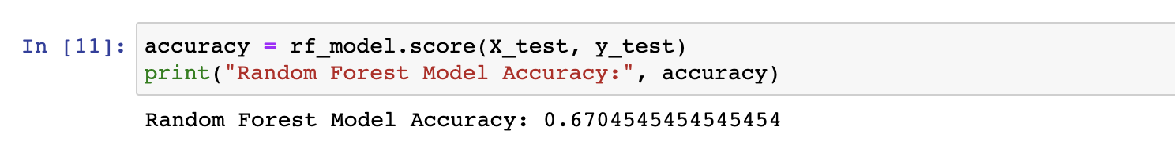
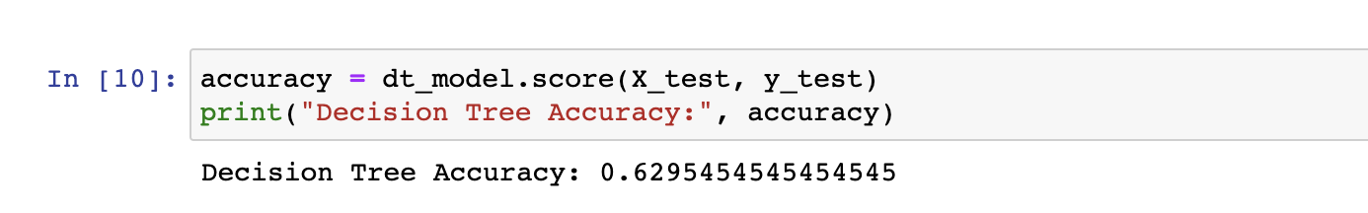
Results
Accuracy of the three models trained
Random Forest Model - Decision Tree Model - Support Vector Classifier Model -
05/23/2023
IT20233808 | Samarakoon S.M.A.D. | Project ID: TMP-23-113

Slide 22
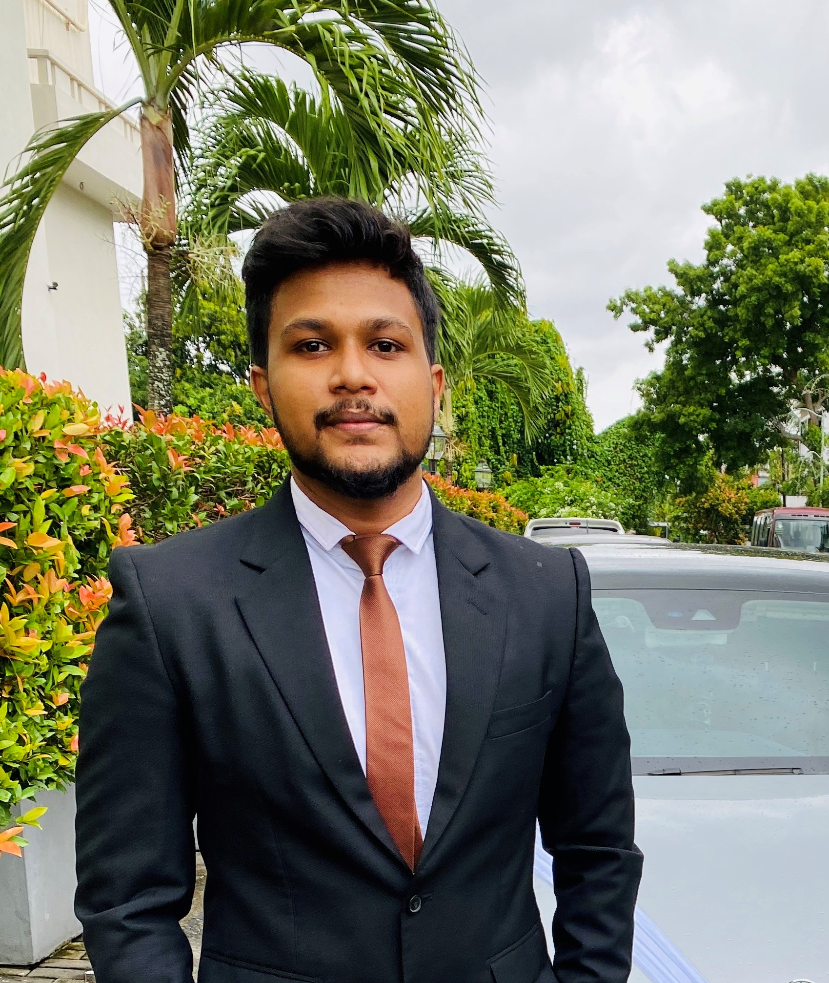
IT20224820 | Ihalagedara I.H.U.B
Bachelor of Science (Hons) in Information Technology Specializing in Software Engineering
IT20224820 | Ihalagedara I.H.U.B | Project ID: TMP-23-113
05/23/2023
22

Slide 23
Target Problem
Target problem –
Provide the users with the knowledge about pest and the organic pest controlling solutions. None of the available systems are capable of identifying pests with the concept of augmented reality and Sri Lankan based organic solution providing mechanism.
Proposed solution –
Proposed solution is to provide a pretrained system to identify pests and provide them with the solutions. The concept of augmented reality is used to identify the objects and it would be more convenient and efficient to use.
IT20224820 | Ihalagedara I.H.U.B | Project ID: TMP-23-113
05/23/2023

Slide 24
CURRENT PROGRESS – IT20224820 (90%)
Gather dataset and preprocess the data to be more useful.
Data augmentation and noise reduction.
Train a model with the data set which is capable of identifying 15 different classes of pests with the YOLO algorithm.
Create a flask server and use the created best model to get the predictions.
Create a react native user interfaces and use the created API's to get objects detected using the flask server and upload the to cloud.
Get the results with the bounded image and display it.
IT20224820 | Ihalagedara I.H.U.B | Project ID: TMP-23-113
05/23/2023

Slide 25
NEXT EXPECTED PROGRESS (100% COMPLETION) IT20224820
Usage of a system to provide nonchemical and organic solutions to help the crop rotation in Sri Lanka.
Identifying the pests through the augmented reality and provide the traditional and organic solutions.
Creation of algorithm system for provide the necessary solutions.
Deploy the flask server and the react native in the cloud environment.
IT20224820 | Ihalagedara I.H.U.B | Project ID: TMP-23-113
05/23/2023

Slide 26
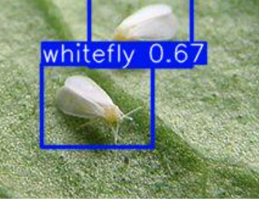
Results
The model was trained 6458 images representing 15 different classes.
Each class having around 400-500 images.
F1 score - 0.91 for all classes
Precision confidence curve – 1 at 0.912

Slide 27
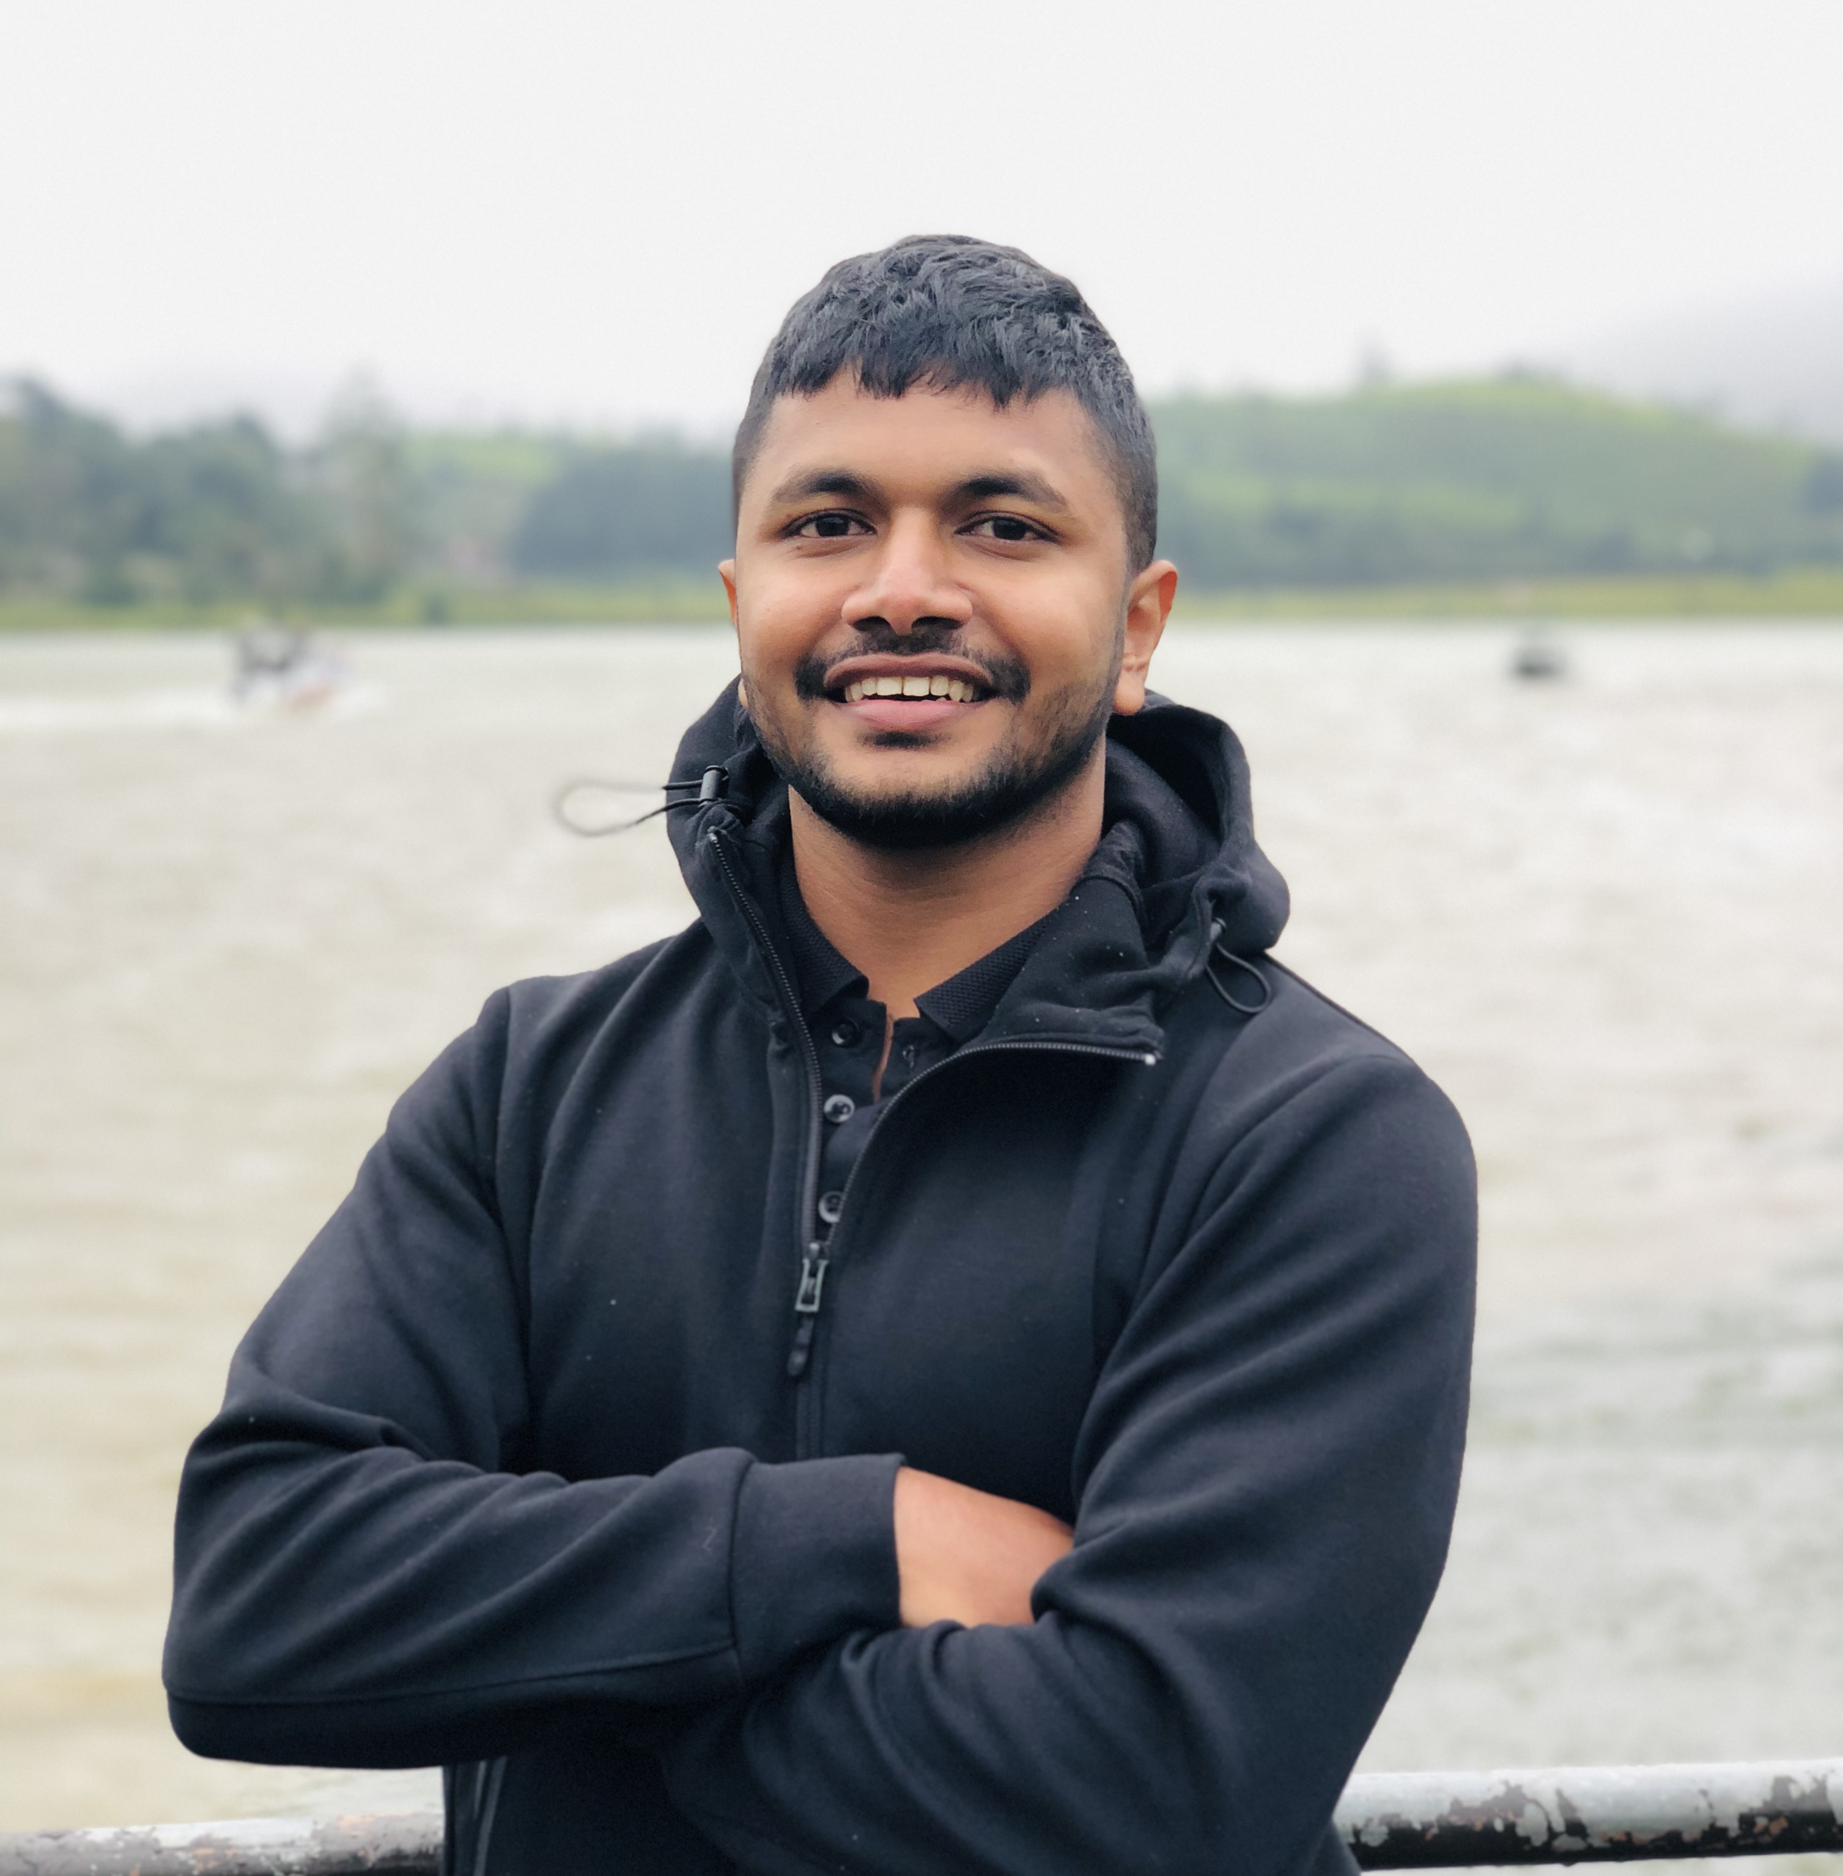
IT20151874 | Waththaladeniya N.M
Bachelor of Science (Hons) in Information Technology Specializing in Software Engineering
IT20151874 | Waththaladeniya N.M | Project ID: TMP-23-113
05/23/2023
27

Slide 28
Target Problem
Target problem -
Current marketplace does not contain a way to identify the real time weather like humidity and temperature using IOT device and get the suitable crop and various information about the crop.
Propose system -
To develop a system which can identify suitable crop based on the area weather condition and provide weather data for next month and suggest solution to reduce impact on weather changes.
IT20151874 | Waththaladeniya N.M | Project ID: TMP-23-113
05/23/2023

Slide 29
Current progress(90%) – IT20151874
Configure IOT device and integrate it with mobile app to identify the weather condition.
Trained data model using decision tree algorithm to recommend the crop based on the current weather data.
Implemented function to get the current and next 7 days weather condition using a web API.
Implemented the react native mobile app to display most suitable crop and weather conditions.
IT20151874 | Waththaladeniya N.M | Project ID: TMP-23-113
05/23/2023

Slide 30
Next Expected progress (100% completion) IT20151874
Integrate IOT data with application.
Identify the weather conditions for next 7days using web api.
Recommend most suitable crop according to the weather condition.
Provide solution to reduce the impact on weather changes.
IT20151874 | Waththaladeniya N.M | Project ID: TMP-23-113
05/23/2023

